Slide 1
Popular Programming Tech
Part 6
Function Declaration

Slide 2
Learning Objective
LO 2 : Apply GO programming language techniques and libraries

Slide 3
Outline
Function declarations
Recursion
Multiple return values
Errors
Function values
Anonymous functions
Variadic functions
Deferred function calls
Panic
Recover
Method Declarations
Methods with a pointer reciever
Composing types by struct embedding
Method values and expressions
encapsulations

Slide 4

Function Declarations
A function lets us wrap up a sequence of statements as a unit that can be called from elsewhere in a program, perhaps multiple times
Functions make it possible to break a big job into smaller pieces that might well be written by different people separated by both time and space

Slide 5
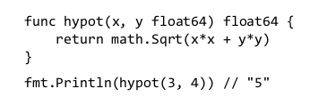
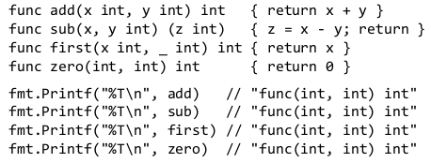
The parameter list specifies the names and types of the function’s parameters, which are the local variables whose values or arguments are supplied by the caller
Here are four ways to declare a function with two parameters and one result, all of type int. The blank identifier can be used to emphasize that a parameter is unused

Slide 6
Recursion
Functions may be recursive, that is, they may call themselves, either directly or indirectly
Recursion is a powerful technique for many problems, and of course it’s essential for processing recursive data structures

Slide 7
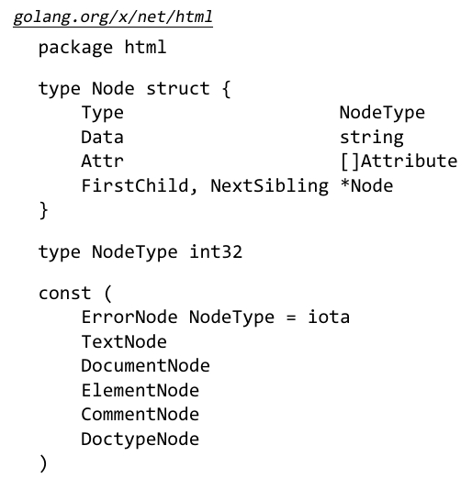
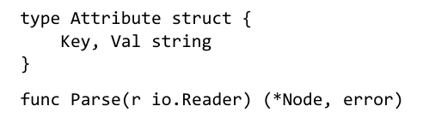

Slide 8
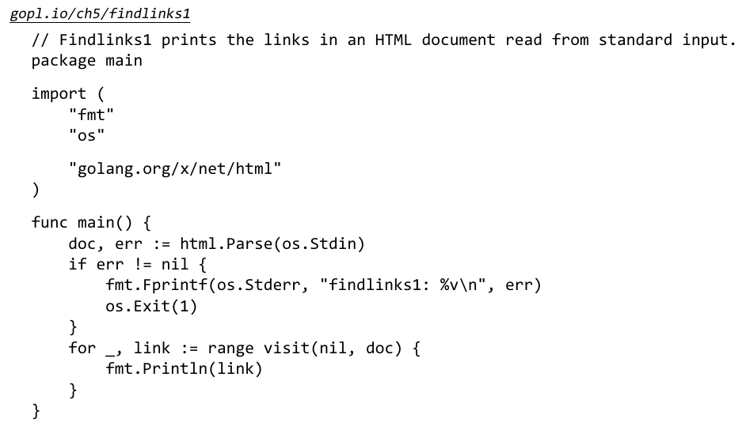
The main function parses the standard input as HTML, extracts the links using a recursive visit function, and prints each discovered link
The visit function traverses an HTML node tree, extracts the link from the href attribute of each anchor element <a href='...'>, app ends the links to a slice of strings, and returns the resu lting slice

Slide 9
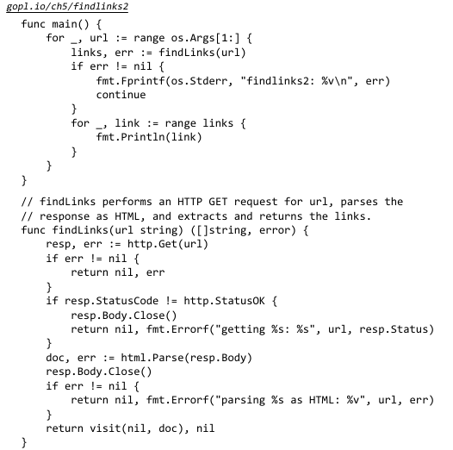

Multiple Return Values
There are four return statements in findLinks, each of which returns a pair of values

Slide 10

Errors
For many other functions, even in a well-written program, success is not assured because it depends on factors beyond the programmer’s control
Errors are thus an important part of a package’s API or an application’s user interface, and failure is just one of several expected behaviors

Slide 11


Error-Handling Strategies
When a function call returns an error, it’s the caller’s responsibility to check it and take appropriate action
First, and most common, is to propagate the error, so that a failure in a subroutine becomes a failure of the calling routine

Slide 12
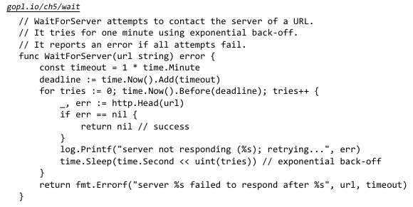
For errors that represent transient or unpredictable problems, it may make sense to retry the failed operation, possibly with a delay between tries

Slide 13

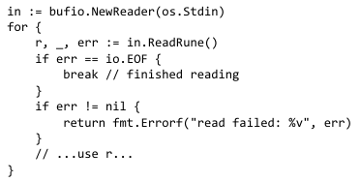
End of File (EOF)
Usually, the var iety of errors that a function may retur n is interesting to the end user but not to the int ervening program logic

Slide 14
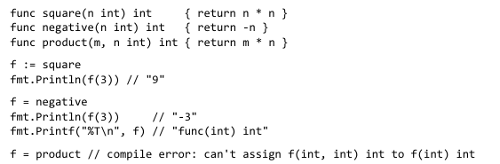
Function Values
Func tions are first-class values in Go: like other values, function values have typ es, and they may be assigned to variables or passed to or returned from functions

Slide 15

Anonymous Functions
Name d functions can be declared only at the package level, but we can use a function literal to denote a function value within any expression
A function literal is written like a function declaration, but without a name following the func keyword

Slide 16
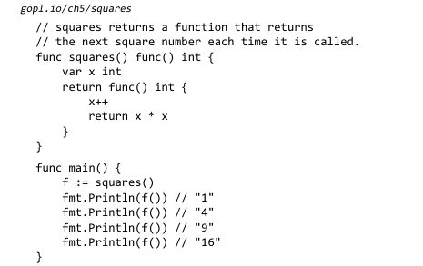

Slide 17
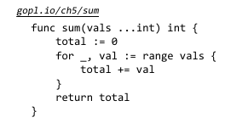
Variadic Functions
A variadic function is one that can be calle d with varying numbers of arguments.
The most familiar examples are fmt.Printf and its variants
Printf requires one fixed argument at the beginning, then accepts any number of subsequent arguments.

Slide 18
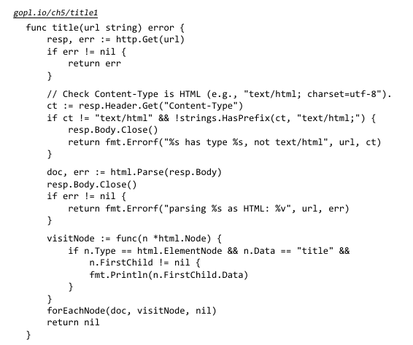
Deferred Function Calls

Slide 19
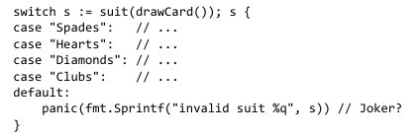
Panic
Go’s type system catches many mistakes at compile time, but others, like an out-of-bounds array access or nil pointer dereference, require checks at run time
When the Go runtime detects these mistakes, it panics
During a typical panic, normal execution stops, all deferred function calls in that goroutine are executed, and the program crashes with a log message
Not all panics come from the runtime. The built-in panic function may be called directly ; it accepts any value as an argument.

Slide 20
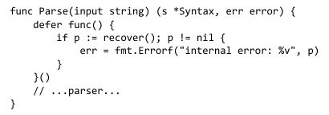
Recover
Giving up is usually the right response to a panic, but not always
It might be possible to recover in some way, or at least clean up the mess before quitting
For example, a web server that encounters an unexpected pro lem could close the connection rat her than leave the client hanging, and during development, it might report the error to the client too

Slide 21
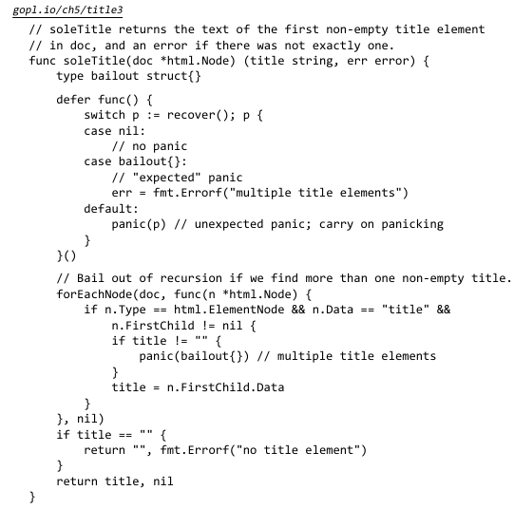
Recovering from a panic within the same package can help simplify the handling of complex or unexpected errors, but as a general rule, you should not attempt to recover from another package’s panic

Slide 22
References
https://go.dev/doc/install
https://www.golangprograms.com/go-language/functions.html

